Slide 1
Training on CM AWARD ONLINE PORTAL
Date: 08-11-2017
Venue: R D Conference Hall

Slide 2
URL
How to access the Online Portal
URL: http://cmawardodisha.in

Slide 3
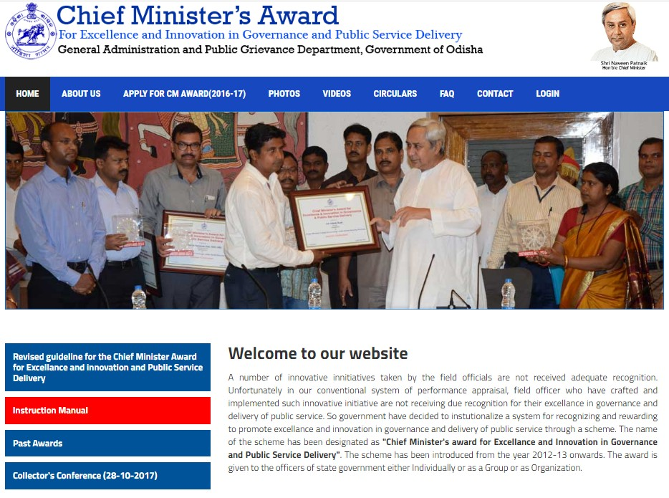
Home Page

Slide 4
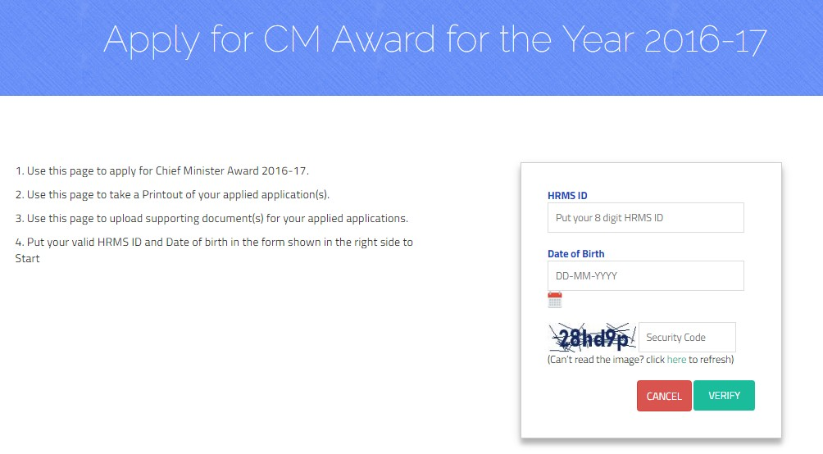
Authentication Page

Slide 5
Application Master

Slide 6
Application Master

Slide 7
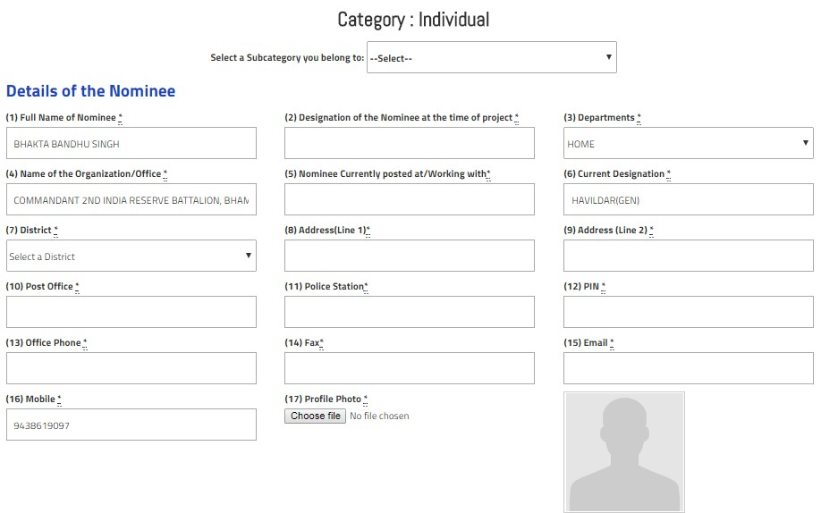
Individual Category (1/3)

Slide 8
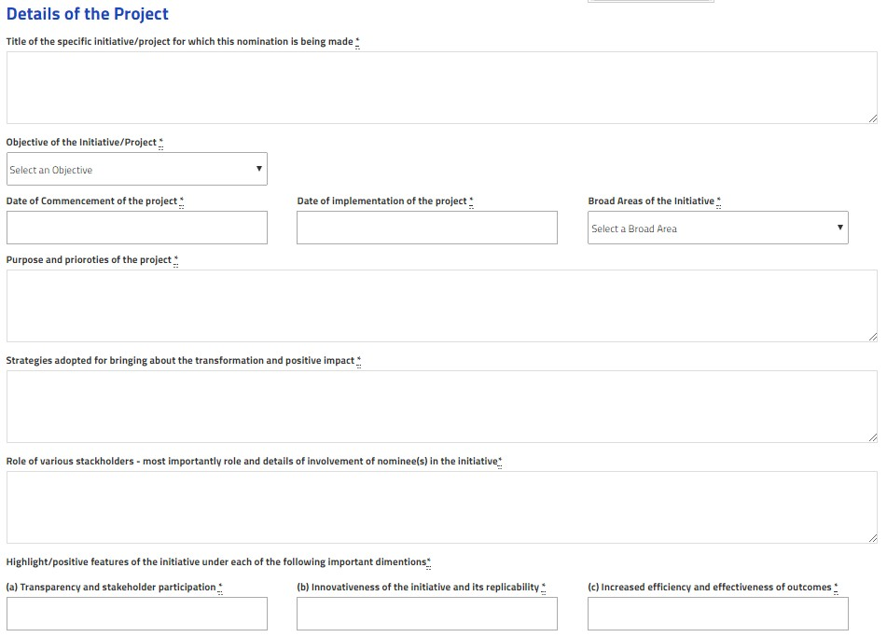
Individual Category(2/3)

Slide 9
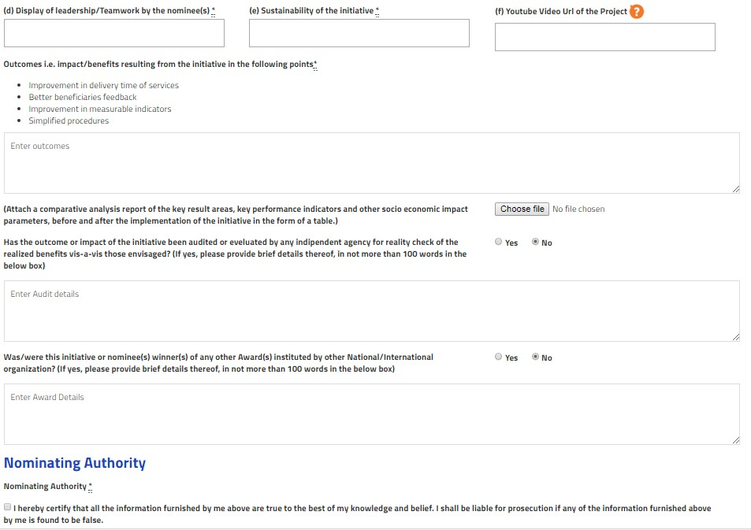
Individual Category (3/3)

Slide 10
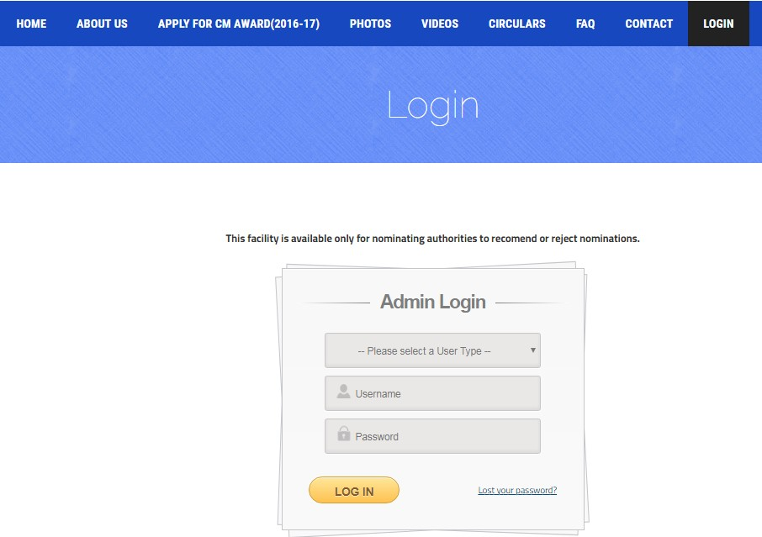
Login for Nominating Authority

Slide 11
First Screen

Slide 12
Applications

Slide 13
Thank You

