Slide 1
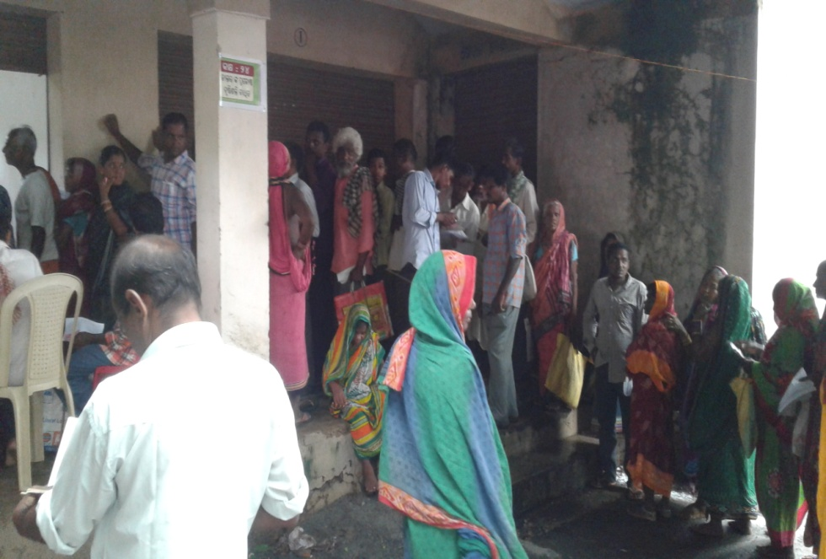
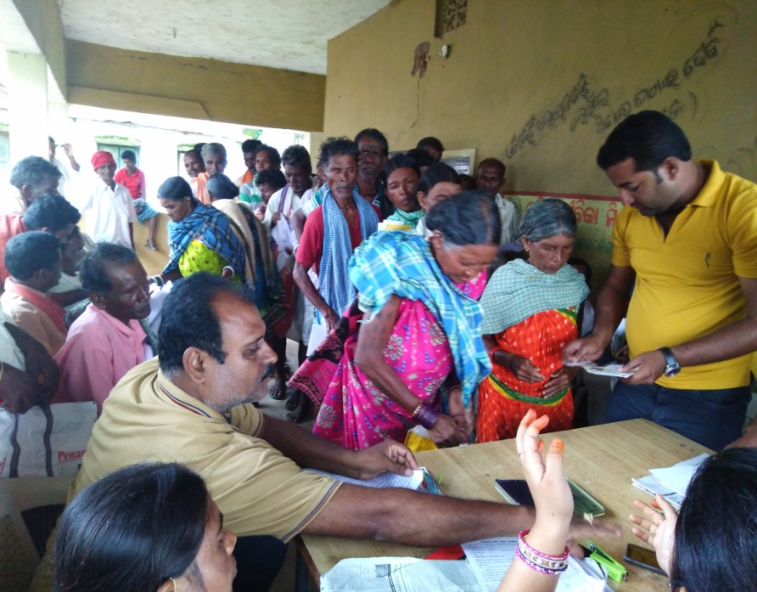
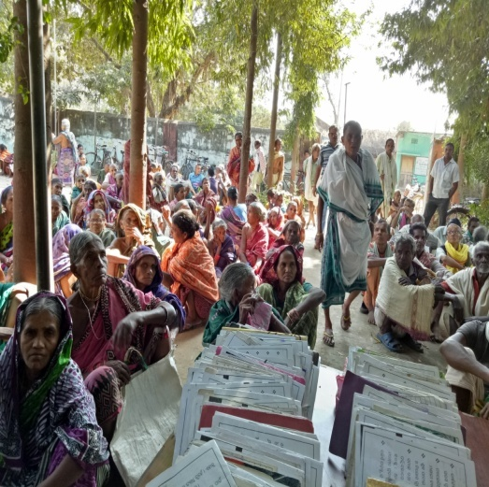
Schemes for Pensioners implemented by Department of Social Security and Empowerment of Persons with Disabilities (SSEPD)

Slide 2
NSAP Schemes
Indira Gandhi National Old Age Pension Scheme (IGNOAPS)
This is one of the components of the ‘National Social Assistance Programme (NSAP) introduced by the Govt. of India, Ministry of Rural Development w.e.f. 15.08.1995.
Under this scheme, old age pension is provided to aged, destitute persons (male/female) of 60 years and above. The rate of pension has been revised to Rs. 300/- per beneficiary per month in between the age of 60-79 years w.e.f. 01.04.2012 and Rs.500/- for 80 years & above w.e.f. 01.04.2011. Out of the above pension, Rs. 200/- is borne by GOI and Rs. 100/- is provided by State Government.
At present, there are 14,18,631 beneficiaries under the scheme.
Eligibility | Financial Assistance (In Rs.)
60-79 Years | ₹300/- Per month Central Share - ₹200/- State Share - ₹100/-
80 Years & above | ₹500/- Per month

Slide 3
Schemes for pensioners
State operates two schemes for indigent pensioners. Madhu Babu Pension Yojana is fully funded by the State Government. National Social Assistance Programme is funded by Government of India and supplemented by the State Government.
Objective:-
Public assistance to citizens in case of unemployment ,old age, sickness and disablement and in other cases of undeserved want.
Social Assistance for the poor with the aim of ensuring a minimum national standard in addition to the benefits that the states are currently providing or might provide in future.

Slide 4
District wise physical and financial achievement under ignoap
District wise Physical and Financial achievement under IGNOAP
SI. No. | Name of Districts | 2015-16 Physical | 2015-16 Financial (In Rs.) | 2016-17 Physical | 2016-17 Financial (In Rs.) | 2017-18 Physical | 2017-18 Financial (In Rs.)
1 | ANGUL | 33512 | 130450732 | 33511 | 132252360 | 33511 | 66265400
2 | BALESHWAR | 74570 | 228283814 | 71394 | 278322100 | 74570 | 153073600
3 | BARGARH | 51288 | 191149400 | 51069 | 191535100 | 51288 | 96647200
4 | BHADRAK | 46769 | 182187200 | 46769 | 183417200 | 46769 | 91814600
5 | BOLANGIR | 70405 | 271444200 | 70137 | 270421800 | 70405 | 137026600
6 | BOUDH | 13520 | 49604600 | 13520 | 50913600 | 13520 | 25584800
7 | CUTTACK | 76758 | 307516800 | 76758 | 309652800 | 76758 | 154906400
8 | DEOGARH | 10882 | 41906000 | 10804 | 42556800 | 10882 | 20718000
9 | DHENKANAL | 41257 | 164973317 | 40933 | 165171288 | 41257 | 83507000
10 | GAJAPATI | 15611 | 60602600 | 15611 | 61924112 | 15611 | 31077800
11 | GANJAM | 103735 | 398101800 | 103735 | 401114800 | 103735 | 197543400
12 | JAGATSINGHAPUR | 43543 | 172654800 | 43523 | 174074800 | 43543 | 85793400
13 | JAJPUR | 61211 | 242842058 | 60111 | 239482700 | 61182 | 122380400
14 | JHARSUGUDA | 16420 | 63177200 | 16420 | 64055200 | 16267 | 31944200

Slide 5
District wise physical and financial achievement under ignoap
District wise Physical and Financial achievement under IGNOAP
SI. No. | Name of Districts | 2015-16 Physical | 2015-16 Financial (In Rs.) | 2016-17 Physical | 2016-17 Financial (In Rs.) | 2017-18 Physical | 2017-18 Financial (In Rs.)
15 | KALAHANDI | 54295 | 201914400 | 54075 | 202227900 | 54295 | 102438200
16 | KANDHAMAL | 19709 | 256099240 | 19408 | 76590400 | 19709 | 38903000
17 | KENDRAPARA | 63395 | 183891800 | 62010 | 252665400 | 63395 | 128961400
18 | KENDUJHAR | 47416 | 198115408 | 46950 | 183951400 | 47416 | 93129241
19 | KHORDHA | 51748 | 252589478 | 51253 | 197665388 | 51588 | 98351200
20 | KORAPUT | 65867 | 114017000 | 65867 | 254703356 | 65867 | 125357400
21 | MALKANGIRI | 29371 | 278000877 | 29371 | 115357872 | 29371 | 57785000
22 | MAYURBHANJ | 70160 | 191454800 | 70160 | 282171652 | 70160 | 140953600
23 | NABARANGAPUR | 50801 | 149996896 | 50801 | 193146800 | 50801 | 95075400
24 | NAYAGARH | 37431 | 159105800 | 36539 | 148255576 | 37431 | 75959800
25 | NUAPADA | 40090 | 75648000 | 40090 | 158713000 | 40090 | 80296400
26 | PURI | 60241 | 234376600 | 60135 | 235695400 | 60341 | 116419800
27 | RAYAGADA | 48184 | 186944000 | 48161 | 188769200 | 48184 | 91496500
28 | SAMBALPUR | 31713 | 121010851 | 31584 | 122644400 | 31610 | 61490800
29 | SONEPUR | 30149 | 116366400 | 30003 | 117158800 | 30028 | 58798400
30 | SUNDARGARH | 58580 | 220529975 | 57235 | 217076687 | 58580 | 109430400
 | TOTAL | 1418631 | 5444956046 | 1407937 | 5511687891 | 1418164 | 2773129341

Slide 6
NSAP Schemes
2. Indira Gandhi National Widow Pension Scheme (IGNWPS)
Govt. of India has launched this scheme during February- 2009. Widows who are between 40-64 years and belonging to house hold below the poverty line (BPL) will be eligible to get pension @ Rs. 300/- per month in the scheme. Subsequently, GOI has revised the age limit to 40-79 years w.e.f. 01.10.12.
At present, 5,13,954 beneficiaries have been covered under this scheme.
Eligibility | Financial Assistance (In Rs.)
40-79 Years | ₹300/- Per month
80 Years & above | ₹500/- Per month

Slide 7
District wise physical and financial achievement under ignwps
District wise Physical and Financial achievement under IGNWPS
SI. No. | Name of Districts | 2015-16 Physical | 2015-16 Financial (In Rs.) | 2016-17 Physical | 2016-17 Financial (In Rs.) | 2017-18 Physical | 2017-18 Financial (In Rs.)
1 | ANGUL | 13594 | 49718400 | 13593 | 49834800 | 13594 | 24469200
2 | BALESHWAR | 25026 | 67570200 | 21259 | 76372900 | 25026 | 45046800
3 | BARGARH | 17972 | 65589200 | 16843 | 60830800 | 17746 | 31942800
4 | BHADRAK | 14736 | 53609600 | 11108 | 40588800 | 14736 | 26524800
5 | BOLANGIR | 18556 | 67871600 | 18427 | 67072400 | 18453 | 33215400
6 | BOUDH | 5531 | 19384700 | 5531 | 20511600 | 5531 | 9955800
7 | CUTTACK | 27815 | 101204000 | 23530 | 85339700 | 27815 | 50067000
8 | DEOGARH | 3630 | 13398000 | 3630 | 13668000 | 3630 | 6534000
9 | DHENKANAL | 14396 | 52565600 | 13862 | 50618600 | 14396 | 25912800
10 | GAJAPATI | 12234 | 44592400 | 12233 | 44638800 | 12234 | 22021200
11 | GANJAM | 49534 | 180062400 | 49534 | 179122400 | 49534 | 89161200
12 | JAGATSINGHAPUR | 10757 | 39335200 | 10757 | 39325200 | 10741 | 19333800
13 | JAJPUR | 19644 | 71428400 | 17517 | 63175200 | 18009 | 32416200
14 | JHARSUGUDA | 6355 | 23368000 | 6355 | 22878000 | 6355 | 11439000

Slide 8
District wise physical and financial achievement under ignwp
District wise Physical and Financial achievement under IGNWP
SI. No. | Name of Districts | 2015-16 Physical | 2015-16 Financial (In Rs.) | 2016-17 Physical | 2016-17 Financial (In Rs.) | 2017-18 Physical | 2017-18 Financial (In Rs.)
15 | KALAHANDI | 22013 | 80186800 | 21998 | 79449100 | 22013 | 39623400
16 | KANDHAMAL | 12253 | 48039600 | 12240 | 44764000 | 12253 | 22055400
17 | KENDRAPARA | 13161 | 91572800 | 12567 | 45841200 | 12787 | 23016600
18 | KENDUJHAR | 25148 | 60624400 | 24708 | 89567000 | 25148 | 45266400
19 | KHORDHA | 20604 | 88770800 | 15758 | 57416200 | 16413 | 29543400
20 | KORAPUT | 24378 | 35056000 | 24371 | 88435600 | 24378 | 43880400
21 | MALKANGIRI | 9585 | 154826000 | 9585 | 35104200 | 9585 | 17253000
22 | MAYURBHANJ | 42535 | 61060400 | 42353 | 153367200 | 42535 | 76563000
23 | NABARANGAPUR | 16764 | 38271600 | 15705 | 57138000 | 16140 | 29052000
24 | NAYAGARH | 10456 | 29281600 | 9934 | 36362400 | 10230 | 18414000
25 | NUAPADA | 8006 | 44980800 | 8006 | 29110200 | 8006 | 14410800
26 | PURI | 17713 | 64556800 | 17612 | 63837600 | 17713 | 31883400
27 | RAYAGADA | 21811 | 79339600 | 21811 | 79219600 | 21811 | 39259800
28 | SAMBALPUR | 12365 | 45304000 | 12365 | 45314000 | 12365 | 22257000
29 | SONEPUR | 6779 | 24974400 | 6741 | 24967600 | 6741 | 12133800
30 | SUNDARGARH | 25219 | 92028400 | 15526 | 56366000 | 18036 | 32464800
 | TOTAL | 528570 | 1888571700 | 495459 | 1800237100 | 513954 | 925117200

Slide 9
NSAP Schemes
3. Indira Gandhi National Disabled Pension Scheme (IGNDPS)
Govt. of India has launched this scheme during February-2009. Persons with severe or multiple disabilities between 18-64 years and belonging to house hold below the poverty line (BPL) will be eligible to get pension @ Rs. 300/- per month in the above scheme. Subsequently, Government of India has revised the age limit to 18-79 years w.e.f. 01.10.2012.
At present 79,645 beneficiaries have been covered under this Scheme.
Eligibility | Financial Assistance (In Rs.)
18-79 Years | ₹300/- Per month
80 Years & above | ₹500/- Per month

Slide 10
District wise physical and financial achievement under igndps
District wise Physical and Financial achievement under IGNDPS
SI. No. | Name of Districts | 2015-16 Physical | 2015-16 Financial (In Rs.) | 2016-17 Physical | 2016-17 Financial (In Rs.) | 2017-18 Physical | 2017-18 Financial (In Rs.)
1 | ANGUL | 2651 | 9543600 | 1955 | 16184000 | 2060 | 6235200
2 | BALESHWAR | 4710 | 12717000 | 2962 | 26449100 | 4161 | 10458600
3 | BARGARH | 3909 | 14072400 | 3886 | 27470600 | 3909 | 11794200
4 | BHADRAK | 3798 | 13672800 | 2940 | 23025600 | 2986 | 10040400
5 | BOLANGIR | 2864 | 10310400 | 2864 | 20588600 | 2846 | 8750400
6 | BOUDH | 857 | 3085200 | 857 | 6022800 | 857 | 2579400
7 | CUTTACK | 5985 | 21546000 | 3891 | 35746800 | 4267 | 15859800
8 | DEOGARH | 912 | 3823200 | 912 | 6394200 | 912 | 2739600
9 | DHENKANAL | 2616 | 9417600 | 2268 | 16750140 | 2280 | 7326000
10 | GAJAPATI | 1209 | 4352400 | 1209 | 8486800 | 1209 | 3635400
11 | GANJAM | 7795 | 28062000 | 6525 | 49941200 | 7153 | 22794600
12 | JAGATSINGHAPUR | 2427 | 8737200 | 1946 | 15095200 | 2007 | 6646200
13 | JAJPUR | 4623 | 16642800 | 4347 | 31021800 | 4401 | 13692600
14 | JHARSUGUDA | 1361 | 4899600 | 746 | 7360600 | 750 | 3000000

Slide 11
District wise physical and financial achievement under igndps
District wise Physical and Financial achievement under IGNDPS
SI. No. | Name of Districts | 2015-16 Physical | 2015-16 Financial (In Rs.) | 2016-17 Physical | 2016-17 Financial (In Rs.) | 2017-18 Physical | 2017-18 Financial (In Rs.)
15 | KALAHANDI | 2898 | 10432800 | 2894 | 20439300 | 2913 | 8800200
16 | KANDHAMAL | 1631 | 11678400 | 1424 | 10739800 | 1535 | 4744200
17 | KENDRAPARA | 3244 | 5975100 | 2970 | 21434400 | 3244 | 9867600
18 | KENDUJHAR | 3082 | 18118800 | 1620 | 15904000 | 1735 | 6905400
19 | KHORDHA | 5544 | 9075600 | 4886 | 33713200 | 5008 | 15066000
20 | KORAPUT | 2521 | 3513600 | 2512 | 17713200 | 2518 | 7592400
21 | MALKANGIRI | 976 | 17362800 | 976 | 6858800 | 976 | 2937600
22 | MAYURBHANJ | 4823 | 9010800 | 3569 | 28877200 | 4823 | 14692200
23 | NABARANGAPUR | 2503 | 7653600 | 2446 | 16895200 | 2466 | 7472400
24 | NAYAGARH | 2126 | 4442400 | 2017 | 14336400 | 2126 | 6480000
25 | NUAPADA | 1234 | 5534100 | 1234 | 8654500 | 1234 | 3727200
26 | PURI | 4854 | 17474400 | 3074 | 27264800 | 3281 | 5905800
27 | RAYAGADA | 1904 | 6854400 | 1153 | 10304400 | 1154 | 4384800
28 | SAMBALPUR | 2630 | 9468000 | 2373 | 17692200 | 2373 | 7500600
29 | SONEPUR | 1198 | 4312800 | 1198 | 8426800 | 1198 | 3608400
30 | SUNDARGARH | 3869 | 13928400 | 2861 | 22979400 | 3263 | 10629000
 | TOTAL | 90754 | 315718200 | 74515 | 572771040 | 79645 | 245866200

Slide 12
Madhu babu pension yojana (mbpy)
4. Madhu Babu Pension Yojana (MBPY)
To Compensate for the loss of earning capacity of citizens such as the elderly, diseased, invalid and widows and to protect them from impending destitution the State Government has instituted the Madhu Babu Pension Yojana.
Madhu Babu Pension Yojana (MBPY) has been introduced in the state of Odisha w.e.f 01.01.2008 by merging two pension schemes. i.e. State Old Age Pension Scheme and Odisha Disability Pension Scheme. All the beneficiaries being covered under the State Old Age Pension Scheme and the Odisha Disability Pension Scheme in the State have been subsumed under Madhu Babu Pension Yojana from the date it came in to force i.e., 01.01.2008.
At present 79,645 beneficiaries have been covered under this Scheme.

Slide 13
Madhu babu pension yojana (mbpy)
Eligibility | Financial Assistance (In Rs.)
BPL Card holders or Families having annual income less than ₹24000/- | ₹300/- Per month up to 79 years of age
Disabled persons having 40% and above disability / pension for unmarried women having 30 years of age and above | ₹500/- Per month 80 years and above

Slide 14
Madhu babu pension yojana (mbpy)
District wise Physical and Financial achievement under MBPY for 2015-16, 2016-17 and 2017-18
Sl. No. | District | 2015-16 | 2016-17 Physical | 2016-17 Financial (In Rs.) | 2017-18 Physical | 2017-18 Financial (In Rs.)
1 | ANGUL | 53766 | 62135 | 222336200 | 62135 | 116220600
2 | BALESHWAR | 87599 | 100193 | 364117800 | 100193 | 188979000
3 | BARGARH | 68444 | 85601 | 300746200 | 85601 | 161987400
4 | BHADRAK | 66879 | 76299 | 275735400 | 76299 | 143153400
5 | BOLANGIR | 74142 | 77646 | 289691800 | 77646 | 146187600
6 | BOUDH | 21377 | 27155 | 95091600 | 27155 | 51510600
7 | CUTTACK | 114485 | 133158 | 480848600 | 133158 | 250611600
8 | DEOGARH | 16150 | 18576 | 68097600 | 18576 | 35397600
9 | DHENKANAL | 60435 | 69467 | 249036600 | 69467 | 129616200
10 | GAJAPATI | 36564 | 43251 | 152067000 | 43251 | 80136600
11 | GANJAM | 165590 | 192576 | 689555200 | 192576 | 361005600
12 | JAGATSINGHAPUR | 52460 | 60972 | 221525600 | 60972 | 115564800
13 | JAJPUR | 89820 | 95960 | 360960400 | 95960 | 183676800
14 | JHARSUGUDA | 25145 | 29977 | 107538400 | 29977 | 56664600
15 | KALAHANDI | 86451 | 99485 | 340971300 | 99485 | 187311000

Slide 15
Madhu babu pension yojana (mbpy)
District wise Physical and Financial achievement under MBPY for 2015-16, 2016-17 and 2017-18
Sl.No. | District | 2015-16 | 2016-17 Physical | 2016-17 Financial (In Rs.) | 2017-18 Physical | 2017-18 Financial (In Rs.)
16 | KANDHAMAL | 67787 | 76183 | 271180200 | 76183 | 140847000
17 | KENDRAPARA | 74609 | 82209 | 304636800 | 82209 | 140605800
18 | KENDUJHAR | 79274 | 92258 | 328615800 | 92258 | 172507200
19 | KHORDHA | 90168 | 102507 | 373237400 | 102507 | 195043800
20 | KORAPUT | 70507 | 80707 | 285502000 | 80707 | 148500600
21 | MALKANGIRI | 33030 | 38600 | 134823900 | 38600 | 70546800
22 | MAYURBHANJ | 118256 | 139290 | 491263000 | 139290 | 257644800
23 | NABARANGAPUR | 56219 | 63852 | 229698800 | 63852 | 103112700
24 | NAYAGARH | 47567 | 55157 | 193644400 | 55157 | 101081400
25 | NUAPADA | 37209 | 43451 | 155263400 | 43451 | 80582400
26 | PURI | 71331 | 84385 | 299499000 | 84385 | 154137000
27 | RAYAGADA | 49274 | 56274 | 197564800 | 56274 | 102746400
28 | SAMBALPUR | 53927 | 56915 | 211400200 | 56915 | 107046600
29 | SONEPUR | 30112 | 35279 | 124856800 | 35279 | 65302200
30 | SUNDARGARH | 86447 | 105506 | 373216400 | 105506 | 200041200
TOTAL |  | 19,85,024 | 22,85,024 | 8192722600 | 22,85,024 | 4247769300

Slide 16
District wise aaadhaar seeding and linkage status as on dt.27.10.2017
Aadhar seeding and linkage status under NSAP
Sl. No. | Status on Aadhar seeding |  |  |  |  |  | Sl. No. | Status on Aadhar Verified
 | Name of the District | As on 25th Oct. | As on 27th Oct. | Daywise progress | Aadhar Ach. % |  |  | Name of the District | As on 25th Oct. | As on 27th Oct. | Daywise progress | Aadhar Verif. %
1 | MALKANGIRI | 39,583 | 39,583 | 0 | 99 |  | 1 | KORAPUT | 60,902 | 61,051 | 149 | 66
2 | KORAPUT | 90,259 | 90,365 | 106 | 97 |  | 2 | BARGARH | 43,085 | 43,076 | -9 | 59
3 | MAYURBHANJ | 1,11,265 | 1,11,032 | -233 | 94 |  | 3 | CUTTACK | 61,302 | 61,440 | 138 | 56
4 | NAYAGARH | 44,609 | 44,612 | 3 | 89 |  | 4 | MALKANGIRI | 20,830 | 20,830 | 0 | 52
5 | DEOGARH | 13,154 | 13,206 | 52 | 86 |  | 5 | SAMBALPUR | 23,064 | 23,200 | 136 | 50
6 | BALESHWAR | 85,514 | 85,518 | 4 | 82 |  | 6 | DEOGARH | 7,538 | 7,591 | 53 | 49
7 | SAMBALPUR | 37,919 | 37,997 | 78 | 81 |  | 7 | SUNDARGARH | 41,456 | 41,902 | 446 | 48
8 | SONEPUR | 30,735 | 30,805 | 70 | 81 |  | 8 | BHADRAK | 29,987 | 30,140 | 153 | 46
9 | BARGARH | 55,669 | 55,650 | -19 | 76 |  | 9 | SONEPUR | 17,192 | 17,266 | 74 | 45
10 | KENDRAPARA | 60,484 | 60,595 | 111 | 76 |  | 10 | JHARSUGUDA | 10,774 | 10,792 | 18 | 45
11 | CUTTACK | 83,512 | 83,625 | 113 | 76 |  | 11 | NAYAGARH | 22,011 | 22,064 | 53 | 44
12 | KANDHAMAL | 25,158 | 25,250 | 92 | 75 |  | 12 | KENDUJHAR | 32,650 | 33,019 | 369 | 44
13 | DHENKANAL | 43,710 | 43,781 | 71 | 75 |  | 13 | BOLANGIR | 39,290 | 39,726 | 436 | 43
14 | NABARANGAPUR | 51,296 | 51,341 | 45 | 72 |  | 14 | KENDRAPARA | 33,665 | 34,272 | 607 | 43
15 | BHADRAK | 44,193 | 44,331 | 138 | 68 |  | 15 | GAJAPATI | 12,234 | 12,370 | 136 | 43

Slide 17
District wise aaadhaar seeding and linkage status as on dt.27.10.2017
Aadhar seeding and linkage status under NSAP
Sl. No. | Status on Aadhar seeding |  |  |  |  |  | Sl. No. | Status on Aadhar Verified
 | Name of the District | As on 25th Oct. | As on 27th Oct. | Daywise progress | Aadhar Ach. % |  |  | Name of the District | As on 25th Oct. | As on 27th Oct. | Daywise progress | Aadhar Verif. %
16 | JHARSUGUDA | 16,152 | 16,163 | 11 | 67 |  | 16 | DHENKANAL | 24,629 | 24,702 | 73 | 42
17 | KALAHANDI | 51,412 | 51,432 | 20 | 65 |  | 17 | KANDHAMAL | 12,562 | 12,681 | 119 | 38
18 | GAJAPATI | 18,512 | 18,630 | 118 | 64 |  | 18 | PURI | 28,848 | 29,603 | 755 | 36
19 | NUAPADA | 30,843 | 31,356 | 513 | 64 |  | 19 | ANGUL | 16,953 | 17,058 | 105 | 35
20 | KENDUJHAR | 46,660 | 46,949 | 289 | 62 |  | 20 | KHORDHA | 25,154 | 25,428 | 274 | 33
21 | GANJAM | 97,040 | 97,437 | 397 | 60 |  | 21 | BALESHWAR | 33,572 | 33,587 | 15 | 32
22 | RAYAGADA | 43,117 | 43,152 | 35 | 60 |  | 22 | JAGATSINGHAPUR | 17,739 | 18,006 | 267 | 32
23 | JAGATSINGHAPUR | 33,792 | 33,889 | 97 | 60 |  | 23 | BOUDH | 5,331 | 5,497 | 166 | 28
24 | PURI | 46,561 | 47,091 | 530 | 57 |  | 24 | GANJAM | 41,896 | 42,473 | 577 | 26
25 | SUNDARGARH | 49,224 | 49,644 | 420 | 57 |  | 25 | RAYAGADA | 18,557 | 18,593 | 36 | 26
26 | ANGUL | 27,366 | 27,470 | 104 | 56 |  | 26 | MAYURBHANJ | 29,786 | 29,778 | -8 | 25
27 | BOLANGIR | 50,482 | 50,901 | 419 | 55 |  | 27 | NUAPADA | 9,361 | 10,055 | 694 | 20
28 | KHORDHA | 42,722 | 42,958 | 236 | 55 |  | 28 | NABARANGAPUR | 13,879 | 13,935 | 56 | 20
29 | BOUDH | 9,723 | 9,796 | 73 | 49 |  | 29 | JAJPUR | 14,350 | 15,489 | 1139 | 18
30 | JAJPUR | 40,695 | 41,462 | 767 | 49 |  | 30 | KALAHANDI | 10,386 | 10,451 | 65 | 13
 | TOTAL | 1421361 | 1426021 | 4660 | 70 |  |  | TOTAL | 758983 | 766075 | 7092 | 38

Slide 18
Critical issues for improving implementation of the schemes/ programmes
Disbursement of pensions on 15th of every month.
All old age pension beneficiaries under NSAP and MBPY who are registered construction workers to be shifted to NSPY. List of pension beneficiaries to be given to District Labour Officer for filtering.
Aadhaar based authentication of pension beneficiaries to be ensured before disbursement of pensions.
Aadhaar seeding and digitization of database of beneficiaries to be completed.
Pension disbursement to be reflected in NSAP portal- www.nsap.nic.in

Slide 19
Critical issues for improving implementation of the schemes/ programmes
Flow of funds to be recorded in PFMS from State, District, Block and GP levels.
Pending Utilization Certificates (UCs) to be submitted.
Cash for pension disbursement to be moved free of cost to GPs from block headquarters through cash delivery vans of ICICI, AXIS and HDFC Banks.
Convergence with Department of Health & Family Welfare for screening of health of pension beneficiaries and free drug distribution under NIRAMAYA on pension distribution day.

Slide 20
District wise additional requirement under mbpy
Additional Requirement of Pensions under MBPY
Sl. No. | District | Identified beneficiaries to be covered
1 | Angul | 12007
2 | Balasore | 12764
3 | Baragarh | 40365
4 | Bhadrak | 4774
5 | Bolangir | 19525
6 | Boudh | 6938
7 | Cuttack | 47588
8 | Deogarh | 3163
9 | Dhenkanal | 12160
10 | Gajapati | 4267
11 | Ganjam | 44916
12 | Jagatsinghpur | 8024
13 | Jajpur | 10720
14 | Jharsuguda | 5351
15 | Kalahandi | 12920

Slide 21
District wise additional requirement under mbpy
Additional Requirement of Pensions under MBPY
Sl. No. | District | Identified beneficiaries to be covered
16 | Kandhamal | 3424
17 | Kendrapara | 12700
18 | Keonjhar | 9269
19 | Khurdha | 4711
20 | Koraput | 1211
21 | Malkangiri | 3175
22 | Mayurbhanj | 15156
23 | Nawrangpur | 8471
24 | Nayagarh | 6500
25 | Nuapada | 3772
26 | Puri | 16200
27 | Rayagada | 7246
28 | Sambalpur | 12558
29 | Sonepur | 2908
30 | Sundergarh | 13717
 | TOTAL | 366500

Slide 22
District wise additional requirement under NSAP
District | Pensioners Additional Requirement Number
 | OAP More than 80 Years | Disability Pension Additional Rs.200/- | Leftout Identified
 | 32 | 33 | 34
Angul | 1220 | 2627 | 12007
Balasore | 5680 | 7084 | 12764
Baragarh | 3637 | 3307 | 4184
Bhadrak | 7680 | 2042 | 4774
Bolangir | 1270 | 2463 | 32697
Boudh | 1055 | 811 | 787
Cuttack | 14638 | 4554 | 27588
Deogarh | 247 | 305 | 469
Dhenkanal | 3393 | 2062 | 12160
Gajapati | 565 | 1326 | 4267
Ganjam | 9085 | 10884 | 2662
Jagatsinghpur | 4291 | 2500 | 12446
Jajpur | 1744 | 1757 | 3501
Jharsuguda | 1048 | 434 | 5351
Kalahandi | 1929 | 927 | 1179

Slide 23
District wise additional requirement under NSAP
District | Pensioners Additional Requirement Number
 | OAP More than 80 Years | Disability Pension Additional Rs.200/- | Leftout Identified
Kandhamal | 2094 | 3158 | 0
Kendrapara | 2700 | 2989 | 10000
Keonjhar | 2357 | 678 | 9269
Khurdha | 2461 | 3153 | 2250
Koraput | 60 | 134 | 3536
Malkangiri | 207 | 251 | 3175
Mayurbhanj | 7190 | 2750 | 0
Nawrangpur | 20 | 362 | 8471
Nayagarh | 5945 | 3880 | 10700
Nuapada | 2223 | 1436 | 3772
Puri | 8654 | 5785 | 26803
Rayagada | 2418 | 1595 | 3233
Sambalpur | 1765 | 725 | 12558
Sonepur | 485 | 1325 | 1761
Sundergarh | 917 | 1914 | 13717
Total | 96978 | 73218 | 246081

Slide 24
THANK YOU

