Slide 1

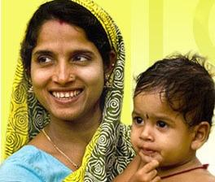
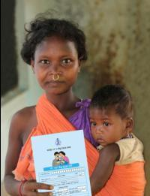
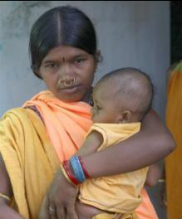
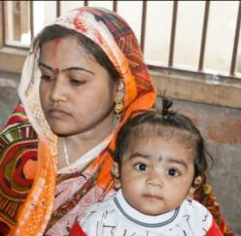
MAMATA
Department of Women & Child Development and Mission Shakti
Government of Odisha

Slide 2

MAMATA/ IGMSY scheme
2011-2016 | Mamata (28 districts) IGMSY ( Bargarh and Sundergarh ) – GoI (1st child, 2nd child and PVTG additional Children)
2017 onwards | Mamata (30 districts; 1st child, 2nd child and PVTG additional children)

Slide 3
Year wise coverage under MAMATA/ IGMSY scheme
Sl. No. | Year | No. of Beneficiaries | Fund released (in crores) | Beneficiaries Exited
1 | 2011 | 167973 | 25.27 | 29
2 | 2012 | 512779 | 168.90 | 104113
3 | 2013 | 464489 | 233.27 | 463922
4 | 2014 | 454095 | 216.08 | 390220
5 | 2015 | 511601 | 280.13 | 595146
6 | 2016 | 477930 | 254.72 | 534297
7 | 2017 | 353377 | 193.08 | 351359
Total |  | 2942244 | 1371.48 | 2439086

Slide 4
Progress under MAMATA/ IGMSY scheme during 2017
1 | 1st installment | 353377 (Old- 110289 + New-243088)
2 | 2nd installment | 250867
3 | 3rd installment | 308500
4 | 4th installment | 351359
5 | Fund released to beneficiaries | 193.08 crore
6 | Fund released towards incentives | 8.05 crore

Slide 5
Progress in last 03 years
Sl No. | DISTRICT | Beneficiaries covered |  |  | Fund released (In Crores)
 |  | 2015 | 2016 | 2017 (till date) | 2015 | 2016 | 2017 (till date)
1 | ANGUL | 14380 | 16192 | 11392 | 8.05 | 8.79 | 6.23
2 | BALASORE | 25772 | 29393 | 22006 | 15.16 | 15.49 | 12.13
3 | BARGARH | 17827 | 15957 | 11109 | 9.36 | 8.53 | 5.80
4 | BHADRAK | 25582 | 13530 | 20491 | 14.39 | 8.27 | 10.02
5 | BOLANGIR | 20431 | 18656 | 12248 | 11.25 | 10.15 | 7.01
6 | BOUDH | 5739 | 4949 | 3156 | 2.92 | 2.79 | 1.69
7 | CUTTACK | 29612 | 28023 | 15926 | 16.32 | 14.41 | 10.07
8 | DEOGARH | 3570 | 3910 | 4000 | 2.08 | 1.92 | 1.74
9 | DHENKANAL | 17955 | 14853 | 11842 | 9.01 | 7.60 | 6.02
10 | GAJAPATI | 6957 | 6775 | 5236 | 3.56 | 3.47 | 2.80

Slide 6
Progress in last 03 years
Sl No. | DISTRICT | Beneficiaries covered |  |  | Fund released (In Crores)
 |  | 2015 | 2016 | 2017(till date) | 2015 | 2016 | 2017(till date)
11 | GANJAM | 42189 | 43038 | 41273 | 22.91 | 24.30 | 20.57
12 | JAGATSINGHPUR | 13204 | 12488 | 8367 | 7.49 | 6.81 | 4.54
13 | JAJPUR | 26138 | 20532 | 16341 | 14.52 | 11.04 | 9.43
14 | JHARSUGUDA | 7041 | 5583 | 4095 | 3.82 | 2.99 | 2.28
15 | KALAHANDI | 17855 | 18978 | 10984 | 10.30 | 9.66 | 6.67
16 | KANDHAMAL | 8042 | 10311 | 6056 | 4.82 | 5.26 | 3.47
17 | KENDRAPARA | 17785 | 17479 | 12868 | 9.94 | 9.37 | 7.37
18 | KEONJHAR | 25532 | 18770 | 16677 | 13.32 | 9.90 | 8.65
19 | KHURDA | 22045 | 20784 | 15406 | 12.11 | 11.30 | 8.27
20 | KORAPUT | 19331 | 16563 | 10662 | 10.16 | 8.54 | 5.85

Slide 7
Progress in last 03 years
Sl No. | DISTRICT | Beneficiaries covered |  |  | Fund released (In Crores)
 |  | 2015 | 2016 | 2017(till date) | 2015 | 2016 | 2017(till date)
21 | MALKANGIRI | 8336 | 8013 | 5202 | 4.67 | 4.19 | 2.92
22 | MAYURBHANJ | 28744 | 28725 | 16692 | 16.21 | 15.12 | 10.15
23 | NAWARANGPUR | 16269 | 15432 | 10904 | 8.27 | 8.13 | 5.68
24 | NAYAGARH | 12222 | 11385 | 7981 | 6.54 | 6.64 | 4.39
25 | NUAPADA | 8733 | 8382 | 4908 | 4.74 | 4.42 | 2.77
26 | PURI | 22052 | 18632 | 17603 | 12.05 | 9.46 | 9.13
27 | RAYAGADA | 9612 | 13137 | 6374 | 5.30 | 6.94 | 3.57
28 | SAMBALPUR | 10571 | 11380 | 6468 | 5.63 | 5.58 | 4.12
29 | SUBARNAPUR | 7436 | 6651 | 5278 | 3.89 | 3.46 | 2.74
30 | SUNDERGARH | 20639 | 19429 | 11832 | 11.33 | 10.21 | 7.00
Total |  | 511601 | 477930 | 353377 | 280.13 | 254.722 | 193.09

Slide 8
Action Points
Ensure 100 % coverage of all pending beneficiaries through effective monitoring regularly.
Project wise analysis may be done on coverage of new beneficiaries of MAMATA scheme.
Expedite the collection of applications from field as the AWWs have already resumed their duty.
Issues related to inoperative bank accounts, generation of RCH number, gaps in fulfilling conditions etc. may be addressed timely by involving bankers, Health dept. officials etc.

