Slide 1
PDS - NFSA
Collectors’ Conference - 28th October 2017
Food Supplies & Consumer Welfare Department

Slide 2
NFSA HIGHLIGHTS
NFSA COVERAGE
86.38 Lakh families, 323.78 Lakh individuals
PHH: 75.43 Lakh families, 285.04 Lakh individuals
AAY: 10.95 Lakh families, 38.74 Lakh individuals
NFSA ENTITLEMENT
PHH: @ 5 Kgs of Rice, Wheat or combination of both per person per month
AAY: @ 35 Kgs of Rice per family per month
UNIFORM PRICE FOR RICE & WHEAT
@ Re. 1/- per Kg
FOOD GRAIN ALLOCATIONS PER MONTH:
Rice - 1.54 Lakh MT Wheat – 24.5 Thousand MT

Slide 3
ACTION POINTS FOR COLLECTORS
Ensure complete lifting of bi-monthly allocation of stocks by 31st October 2017
Start distribution to beneficiaries from 1st November 2017.
Ensure e-PoS based transaction in all Fair Price Shops.
Ensure increase in Aadhaar authenticated transactions through e-PoS.
Ensure reporting of Closing Balance by 26th November 2017.
Assess incoming/pending eligible cases for inclusion in RCMS Centres.
Expedite exclusion of ineligible ration card holders from the database
Accommodate eligible cases in lieu of exclusion
Review collection of death case reports from CHCs/GPs & link it to NFSA Database for exclusion
Expedite seeding of Aadhaar, Bank Account & Mobile number in NFSA database.
Aadhaar Seeding: 77.35 Lakh (families) Lakh 216.14 (individuals)
Percentage of Seeding: 90.3% (families) & 68.5% (individuals)
Bank Account Linking: 84.7% (families)
Mobile Number Linking: 33.7% (families)

Slide 4
Allotment & Lifting Status
SL NO | DISTRICT | RICE (PHH+AAY) |  | WHEAT |  | % OF LIFTING W.R.T. ALLOTMENT
 |  | ALLOTMENT | LIFTING | ALLOTMENT | LIFTING | RICE | WHEAT
1 | ANGUL | 8,675.942 | 2,594.001 | 1,811.897 | 470.756 | 29.9 | 26.0
2 | BALASORE | 16,370.098 | 4,235.822 | 4,076.735 | 781.416 | 25.9 | 19.2
3 | BARAGARH | 11,836.579 | 5,591.894 | 1,239.182 | 502.916 | 47.2 | 40.6
4 | BHADRAK | 9,651.624 | 4,989.636 | 2,769.775 | 790.968 | 51.7 | 28.6
5 | BOLANGIR | 13,942.407 | 5,039.400 | 962.105 | 308.872 | 36.1 | 32.1
6 | BOUDH | 3,764.393 | 1,443.849 | 294.058 | 33.956 | 38.4 | 11.5
7 | CUTTACK | 13,820.757 | 4,566.204 | 5,357.070 | 724.656 | 33.0 | 13.5
8 | DEOGARH | 2,593.020 | 1,569.501 | 366.603 | 208.903 | 60.5 | 57.0
9 | DHENKANAL | 8,784.461 | 5,035.308 | 1,694.585 | 542.942 | 57.3 | 32.0
10 | GAJAPATI | 4,925.027 | 2,524.142 | 213.755 | 107.501 | 51.3 | 50.3
11 | GANJAM | 21,924.250 | 10,678.251 | 3,793.258 | 1,006.049 | 48.7 | 26.5
12 | JAGATSINGHPUR | 6,372.339 | 4,007.954 | 2,743.085 | 941.490 | 62.9 | 34.3
13 | JAJPUR | 12,637.311 | 4,695.540 | 3,101.902 | 855.310 | 37.2 | 27.6
14 | JHARSUGUDA | 3,212.686 | 908.375 | 799.993 | 187.271 | 28.3 | 23.4
15 | KALAHANDI | 14,370.514 | 8,719.689 | 591.833 | 45.724 | 60.7 | 7.7
16 | KANDHAMAL | 6,965.421 | 2,994.032 | 202.071 | 54.122 | 43.0 | 26.8
17 | KENDRAPARA | 8,430.026 | 3,906.002 | 3,440.076 | 1,808.470 | 46.3 | 52.6
18 | KEONJHAR | 15,037.003 | 4,644.644 | 1,519.204 | 374.035 | 30.9 | 24.6
19 | KHORDHA | 11,530.309 | 6,243.867 | 3,399.275 | 910.992 | 54.2 | 26.8
20 | KORAPUT | 13,355.170 | 7,333.883 | 222.857 | 60.928 | 54.9 | 27.3

Slide 5
SL NO | DISTRICT | RICE (PHH+AAY) |  | WHEAT |  | % OF LIFTING W.R.T. ALLOTMENT
 |  | ALLOTMENT | LIFTING | ALLOTMENT | LIFTING | RICE | WHEAT
21 | MALKANGIRI | 6,289.579 | 4,415.497 | 93.934 | 34.270 | 70.2 | 36.5
22 | MAYURBHANJ | 22,896.099 | 11,339.419 | 1,686.877 | 242.461 | 49.5 | 14.4
23 | NAWARANGPUR | 12,163.404 | 8,088.929 | 102.102 | 57.514 | 66.5 | 56.3
24 | NAYAGARH | 6,809.306 | 1,928.516 | 1,335.740 | 366.011 | 28.3 | 27.4
25 | NUAPADA | 5,423.060 | 2,067.423 | 355.485 | 102.463 | 38.1 | 28.8
26 | PURI | 10,405.680 | 4,765.263 | 2,697.078 | 974.637 | 45.8 | 36.1
27 | RAYAGADA | 9,773.625 | 4,735.647 | 17.892 | 3.288 | 48.5 | 18.4
28 | SAMBALPUR | 7,510.737 | 4,245.277 | 1,037.682 | 455.859 | 56.5 | 43.9
29 | SONEPUR | 4,894.383 | 2,521.626 | 468.695 | 80.762 | 51.5 | 17.2
30 | SUNDERGARH | 13,470.998 | 5,988.143 | 2,384.116 | 731.359 | 44.5 | 30.7
STATE |  | 3,07,836.208 | 1,41,817.734 | 48,778.920 | 13,765.901 | 46.1 | 28.2

Slide 6
Status of Preparedness of Districts for Kharif Procurement 2017
The following ten districts are early procuring ones : Bargarh, Bolangir, Deogarh, Kalahnadi, Malkangiri, Nawarangpur, Nuapada, Rayagada, Sambalpur and Sonepur
These districts will start procuring paddy from November
A review of preparedness of these districts in terms of certain key activities reveal lack of adequate preparedness
The rest 20 districts where procurement will start from December also need to review their preparedness
Collectors are requested to take up immediate follow up action

Slide 7
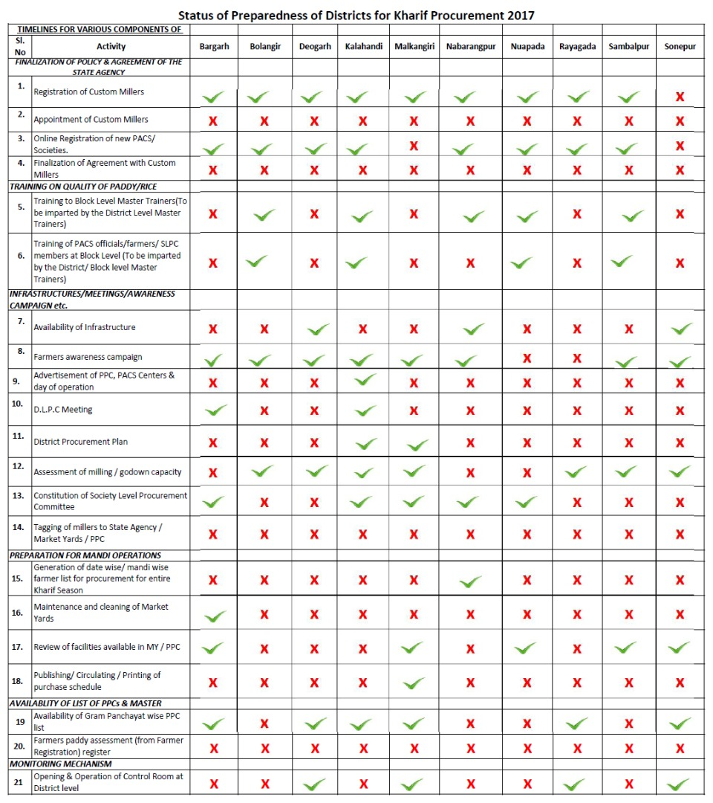
Status of Preparedness of Districts for Kharif Procurement 2017

Slide 8
Thank you for your kind attention

