Slide 1
Housing & Urban Development Department Government of Odisha
Odisha Land Rights to Slum Dwellers Act, 2017

Slide 2
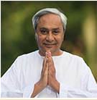
"Today, we had a cabinet for the people who are the lifeline of our cities and towns. They are the silent ones who keep our homes secure and comfortable. It is because of their sacrifice and hard work that the kitchens run, the gardens bloom, the city breathes and we feel secure...It has been the persistent effort of my Government to bring about growth that is inclusive and empowering. Today’s decision will be a landmark step in this regard—setting a benchmark for the entire country.“
Shri Naveen Patnaik
(Media briefing By Hon’ble CM)

Slide 3
Introduction
Odisha Land Rights to Slum Dwellers Ordinance, 2017 – Promulgated on 10th August 2017
Odisha Land Rights to Slum Dwellers Act, 2017 – Notified on 16th October 2017
Settlement of land in actual occupation
Maximum land to be settled
 | Municipality | NAC
In-situ settlement | 45 sq.m | 60 sq.m
Relocation | 30 sq.m | 30 sq.m
EWS Category
Upto 30 sq.m – free of cost
Excess of 30 sq.m - % of benchmark value of land
Other than EWS category - Cost linked to benchmark value of land
Land Rights
Only for residential purposes
Heritable
Mortgagable for housing loan but not transferable
Land rights certificate to be accepted as valid address proof
Urban Poor Welfare Fund
To be set up at ULB level
All revenue out of settlement to be credited to this account
To be utilized only for infrastructure development in the slum or erstwhile areas

Slide 4
The Odisha Land Rights To Slum Dwellers Act 2017 - Definitions
Slum or Slum area:
A compact settlement of at least 20 (twenty) households with a collection of poorly built tenements, mostly of temporary nature, crowded together usually with inadequate sanitary and drinking water facilities in unhygienic conditions, which may be on the State Govt land in an urban area.
Untenable Settlements:
Such areas where existence of human habitation entails undue risk to the safety or health or life of the inhabitants themselves or where habitation on such areas is considered by the Urban Area Slum Redevelopment and Rehabilitation Committee not to be in public interest.

Slide 5
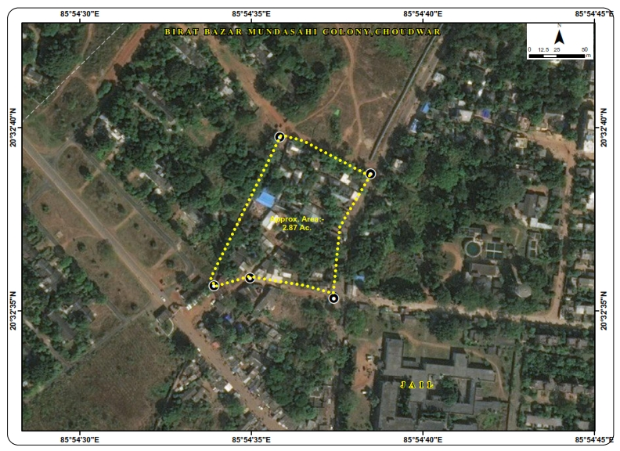
STEP 1: Fixing of Boundaries by Drone Survey
Illustrative
Base map preparation using Drone Survey (high resolution photo imaging)
Mapping on GIS platform

Slide 6
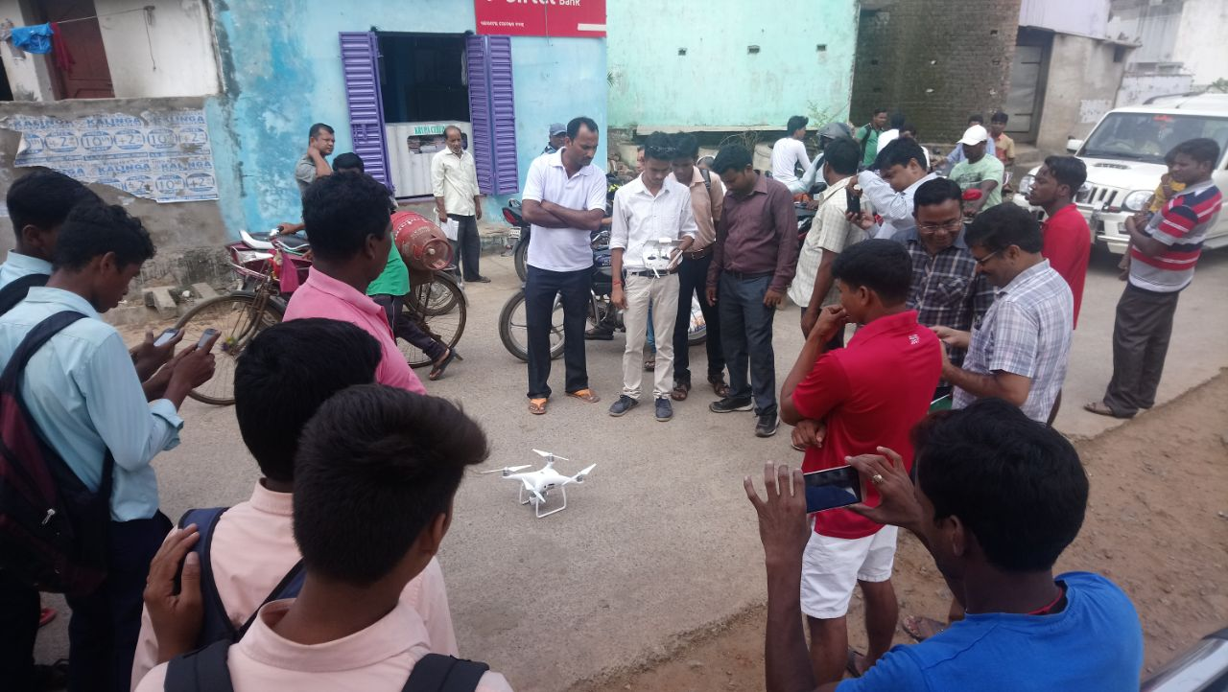
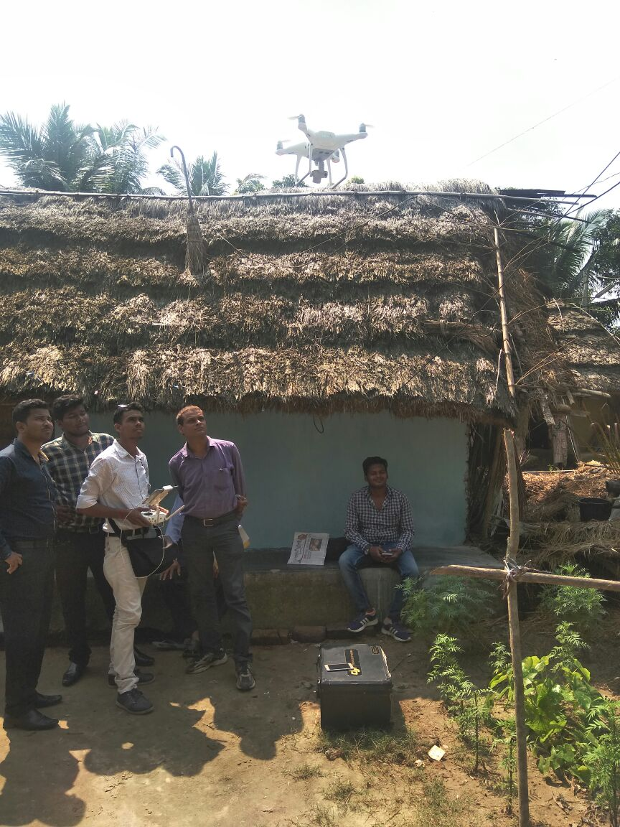
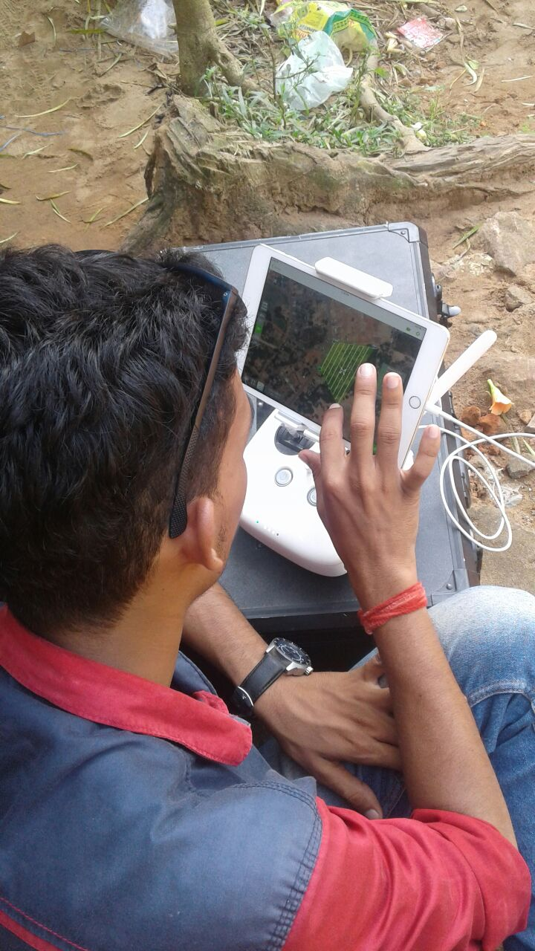
Fixing of slum & household boundaries by drone survey (cont…)

Slide 7
STEP 2: Formation of Slum Associations and Community Sensitization
Engagement of NGO/ CBO by ULB
Formation of Slum Dwellers’ Associations for each identified slum
Local Non-Government Organization / Community Based Organization
Representations from each slum household
President/ Secretary to be nominated by members

Slide 8
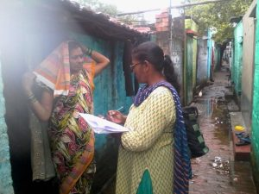
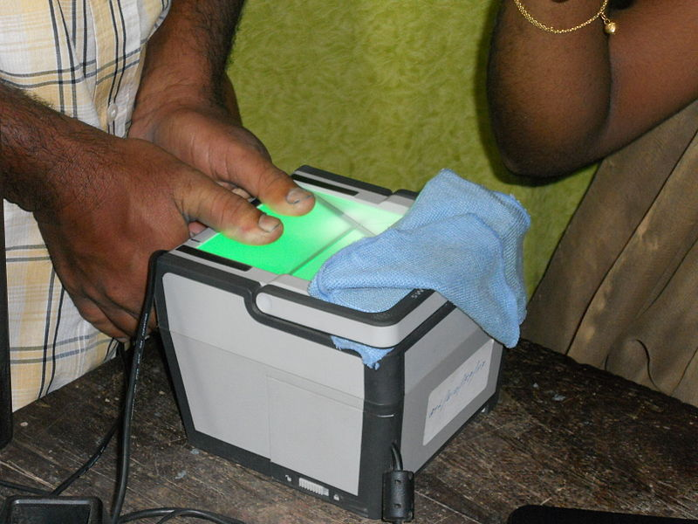
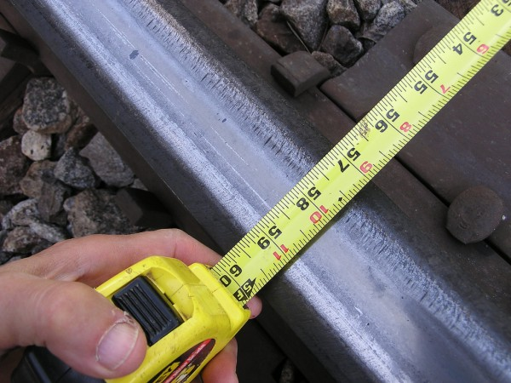
STEP 3: Door-to-door Household Survey
AT DOORSTEP
Filling up of Application Form
Capturing of Biometric details
Measurement of land in actual occupation (involvement of Amin & other officers)
Urban Slum Household Area (USHA) Survey

Slide 9
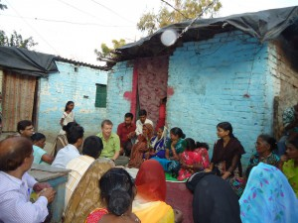
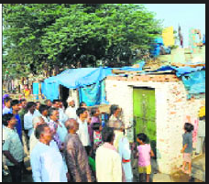
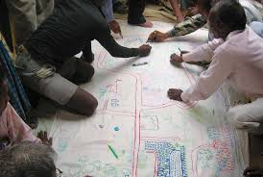
STEP 4: Preparation and Submission of Slum Level Plan
Meetings of members of Slum Dwellers’ Association
facilitated by NGO/ CBO
Preparation of list of eligible slum dwellers
Invitation of objections & suggestions on list & re-layout
plan at slum level (1st phase)
Proposal for re-layout of slum (if any)

Slide 10
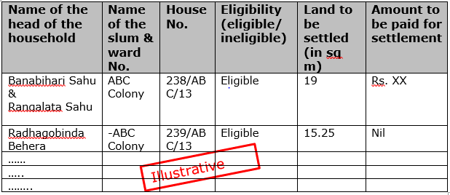
STEP 5: Plan Validation and Verification
Verification of Plan proposal of the slum by Scrutiny Sub-Committee
Preparation of list of eligible slum dwellers by the Urban Area Slum Rehabilitation & Redevelopment Committee
Inviting Objections & suggestions for finalization of list

Slide 11
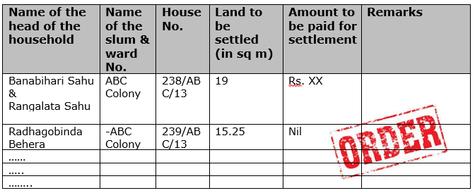
STEP 6: Approval and Issue of Certificate
Order passed by Urban Area Slum Rehabilitation & Redevelopment Committee
Issue of Certificate of Land Rights

Slide 12
Notifications being issued on
Fixing the cut off date for eligibility as 1st January,2017
ULB level Urban Area Slum Redevelopment & Rehabilitation committee (generic)
Appellate authority – concerned RDC
Request sent to R&DM Department for notifying RDC headed committee for conversion of Jalasaya Kisam land wherever required (generic)
ULB wise index value for the extra land – for payment by beneficiaries.

Slide 13
Implementation Status
Sensitization workshop completed at Chhatrapur and Bolangir for Collectors and other officials of Ganjam, Bolangir, Subarnapur and Kalahandi districts.
Piloting started at Konark in Puri district and Chhatrapur, Khallikhote, Polsara, Gopalpur, Chikiti, Kabisuryanagar and Hinjilicut in Ganjam district.
Drone survey completed in 4 slums of Konark, 3 slums of Chhatrapur, 7 slums of Hinjilicut.

Slide 14
Activities to be initiated by Collectors/ULBs
Engagement of NGO/CBO (scope of work- issued)
Selection of members to be nominated to the committee ( from NGO/CMO)
Nomination of Authorized officer for each ULB (Preferably SC/Tahasildar)
Constitution of Scrutiny sub committee with nodal officer & ULB officials to examine the proposal before placing to collector headed slum committee (preferably PD/ADM/SC/LAO)
Identification of suitable Government Land for relocation in respect of untenable slums.

Slide 15
Scope of NGO
Mobilization and formation of Slum Dwellers’ Association (SDA)
Stickering house number of households, door-to-door Urban Slum Household Area (USHA) survey and collection of application form
Assist Municipality/NAC/Tehsil officials during physical survey
Support SDA in finalizing the list of eligible slum dwellers and submit the list to Municipality/NAC
Facilitate SDA in preparing the plan for re-layout of slum area
Support in finalization of plan and proposal after incorporation of suggestions and objections (Phase –I and II)
Coordination with all stakeholders
Monitoring of field-level functionaries and surveyors of implementing partners

Slide 16
District-wise ULB slum details
Sl.No. | District | No. of ULBs | No. of slums | No. of slum HH
1 | Angul | 3 | 64 | 5939
2 | Bolangir | 5 | 108 | 10215
3 | Balasore | 4 | 126 | 14853
4 | Bargarh | 4 | 97 | 10423
5 | Bhadrak | 4 | 77 | 11562
6 | Boudh | 1 | 12 | 3177
7 | Cuttack | 3 | 43 | 5966
8 | Deogarh | 1 | 10 | 792
9 | Dhenkanal | 4 | 42 | 3122
10 | Gajapati | 2 | 23 | 3037
11 | Ganjam | 17 | 191 | 16033
12 | Jagatsinghpur | 2 | 57 | 12105
13 | Jajpur | 2 | 78 | 6539
14 | Jharsuguda | 3 | 158 | 21389
15 | Kalahandi | 4 | 73 | 14713

Slide 17
District-wise ULB slum details
Sl.No. | District | No. of ULBs | No. of slums | No. of slum HH
16 | Kandhamal | 3 | 34 | 3168
17 | Kendrapada | 2 | 68 | 7664
18 | Keonjhar | 5 | 167 | 28655
19 | Khordha | 4 | 57 | 6013
20 | Koraput | 4 | 181 | 15986
21 | Malkangiri | 2 | 17 | 3507
22 | Mayurbhanj | 4 | 73 | 9554
23 | Nayagarh | 5 | 31 | 1329
24 | Nabrangpur | 2 | 14 | 2727
25 | Nuapada | 3 | 17 | 2466
26 | Puri | 4 | 102 | 13902
27 | Rayagada | 3 | 96 | 6715
28 | Sambalpur | 2 | 59 | 3005
29 | Subarnpur | 3 | 67 | 3315
30 | Sundargarh | 3 | 71 | 10465
Total |  | 108 | 2,213 | 2,58,336

Slide 18
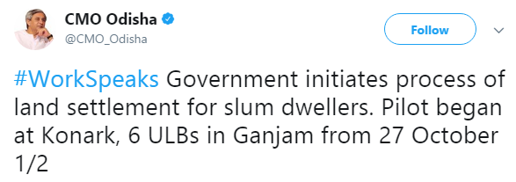
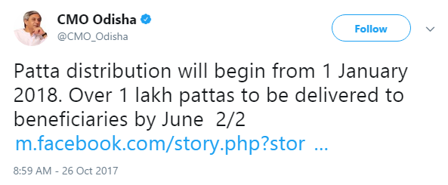
Hon’ble CM’s Tweet

Slide 19
THANK YOU

